Slide 1
Thesis Protein Translocation through a nanopore
Name- Rajat Chaudhary
Roll No. -17807540
Mentor - Dr. Harshwardhan H. Katkar

Slide 2
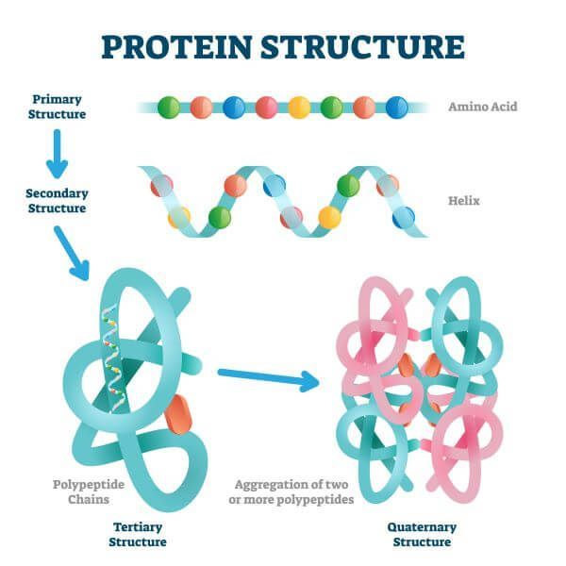
A Few Terminologies
Nanopore: A naturally occurring or artificially created pore of size 1-100 nm is termed as a nanopore
Protein Structures:
Primary
Secondary
Tertiary
Quaternary

Slide 3
Predicting Protein Structures
Primary Structure:
The primary research available on protein translocation through nanopore
Ionic currents are measured with and without the protein present inside the pore, the decrease in this current due to blockage by the protein is then correlated to its primary sequence
Secondary Structure:
Prominent ways include methods using X-ray or spectroscopy
Better accuracy and recent research on using machine learning on available datasets

Slide 4
Coarse Grain Model
Atomistic detail makes simulations slow
Some atoms can be lumped together to form a single entity and now these entities form the basis of the simulation instead of the single atoms
Reduces details but also reduces simulation time drastically
Important to choose right scale so that the simulation is neither insufficiently detailed nor too slow

Slide 5

Langevin Equation
$m\frac{dv}{dt}=−λv+ η(t)$
Where, m – mass of the particle
v – velocity of the particle
$λ$ – friction Coeff.
$η$ – random force
Used to simulate Brownian motion of a particle in a viscous fluid

Slide 6
Current Simulation
LJ units: A type of reduced unit system. Scaling used in the current system:
Mass Scale = 130 g/mol = 2.16 * 10⁻²⁵ kg/particle
Length Scale = 3 Angstroms = 3 * 10⁻¹⁰ m
Energy Scale = K_{B} * T(298.15 K) = 4.11 * 10⁻²¹ J
Time scale(Calculated from above) = 2.17 * 10⁻¹² s
Dimensions of current system:
Diameter of the pore = 1.5 nm = 5 (lj units)
Width/depth of the pore = 6 nm = 20 (lj units)
Length of the polymer chain = 30 nm = 100 (lj units)

Slide 7
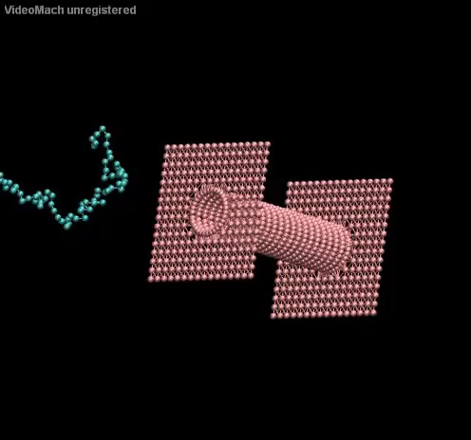
Current Simulation
Simulation time: 2 µs
Movie length: 400 ns
Electric Field outside pore: 10⁸ V/m
Electric Field inside pore: 10⁹ V/m
Bond coefficient: 10 KJ/m²

Slide 8
Thesis Statement
To be decided, probable statement being:
To figure out a reliable way to predict secondary structure of protein using protein translocation through a nanopore (Not much literature available on this, challenge being able to find the way of correlating the secondary structure with some measurable quantity)

Slide 9
Future Objectives
Perform the simulation for 100 initial conditions and measure distribution of time spent by the polymer chain inside the pore
Simulate protein coarse grain models instead of the polymer chain
Decide specifics like electrolyte being used, PH level, metrics to identify correlation

